Slide 1





Capstone Project
BY :- TIRTH PATEL & NACHIKETBHAI PRAJAPATI
TO:- RAHIM SAMEI

Slide 2





Canadian immigration prediction
Introduction
The team
Contribution And Dataset Preparation
Analysis
Results
Conclusions

Slide 3

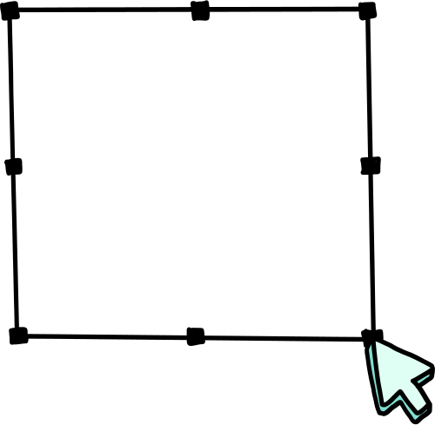

Introduction
Immigration prediction is our project, and today, to improve any business, this is a necessary and crucial aspect to analyze. We are focusing on predicting immigration trends for the country. Among a wide range of prediction models, we are specifically making predictions related to immigration.
Hi there! I’m Nick!

Slide 4




The Team
Took Dataset from Kaggle.com and also reference from canadaimmigration.com
Dataset was good but needed changes in that.
I’m Tirth!

Slide 5





Let's dive into the models we used and the techniques applied to them.
CONTRIBUTION
Linear Regression
Random Forest
LDA
Time series
Linear Regrassion
Random Forest
LDA and Time series
Tirth
Nick
Nick & Tirth

Slide 6
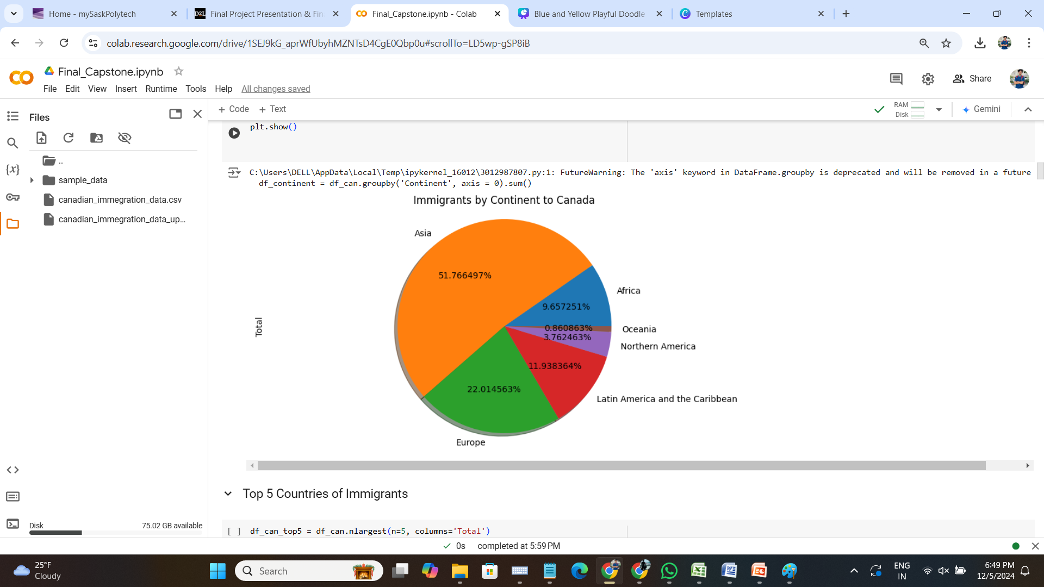

Dataset and Preparation
•The dataset contains immigration statistics for multiple countries over years.
• Dataset preprocessing: Handling null values, dropping unnecessary columns.
• Exploratory Data Analysis: Top 5 and Bottom 5 countries by immigration.

Slide 7

Tirth’s Contribution
• Time Series Analysis: Patterns and trends.
•Linear Discriminant Analysis (LDA): Dimensionality reduction.
• Linear Regression: Predictive modeling.

Slide 8

NACHIKET’S CONTRIBUTION
• Random Forest Classifier: Feature importance.
• Time Series Smoothing: Data preparation for forecasting.
Presentation PPT file
1.
2.

Slide 9
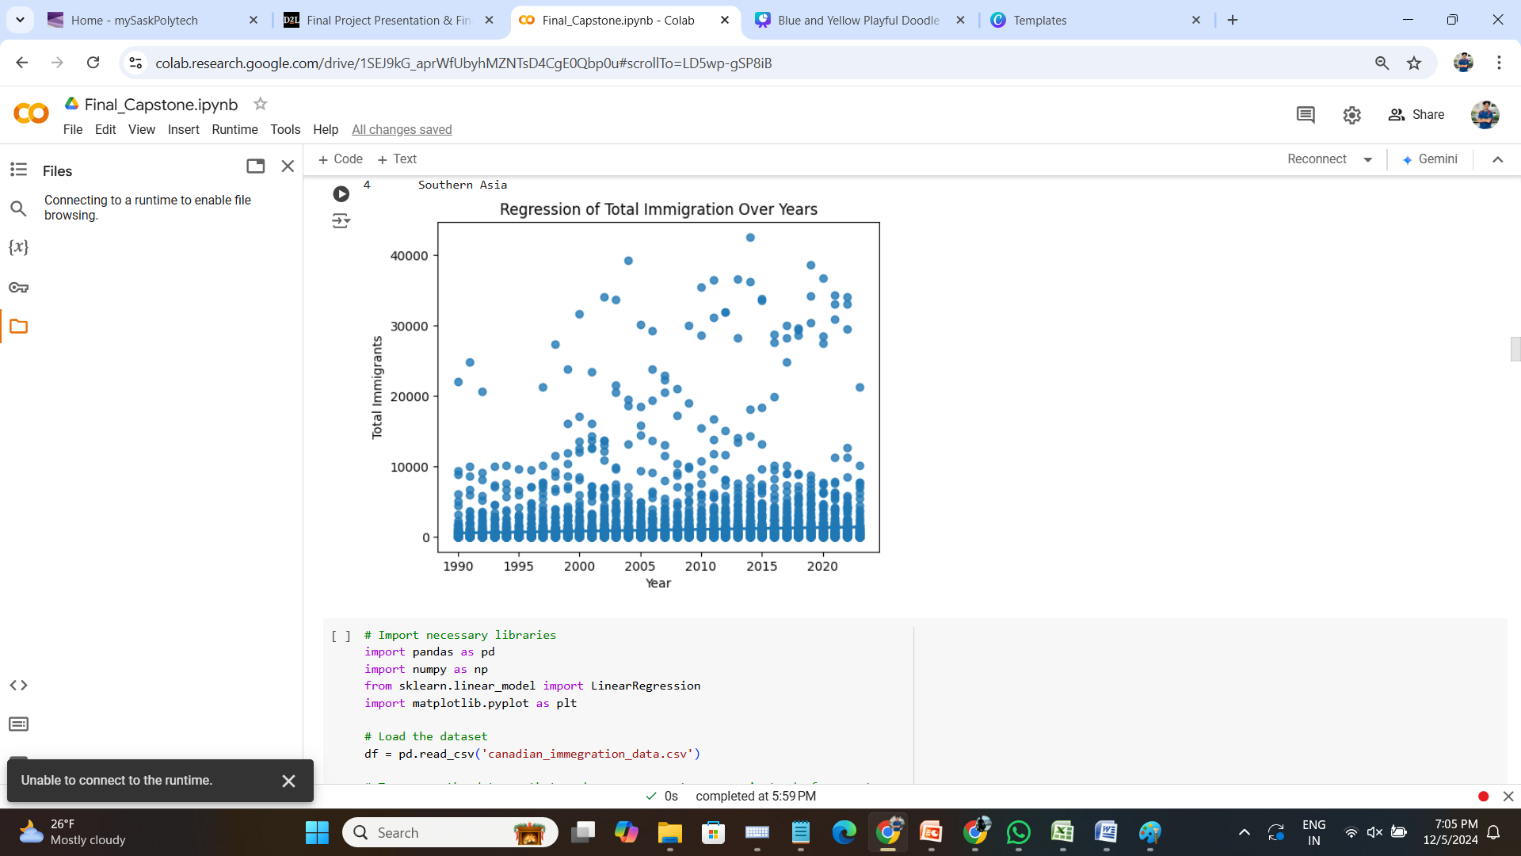
SEABORN ANALYSIS
With Seaborn, you can easily visualize relationships between variables, distribution patterns, and data trends, making it an excellent tool for exploratory data analysis and presentation-quality visuals.

Slide 10


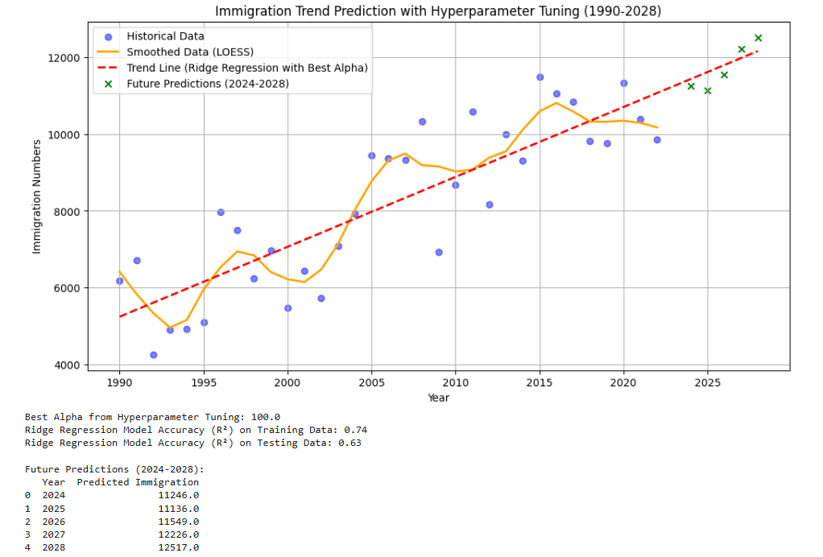

Linear Regression

Slide 11

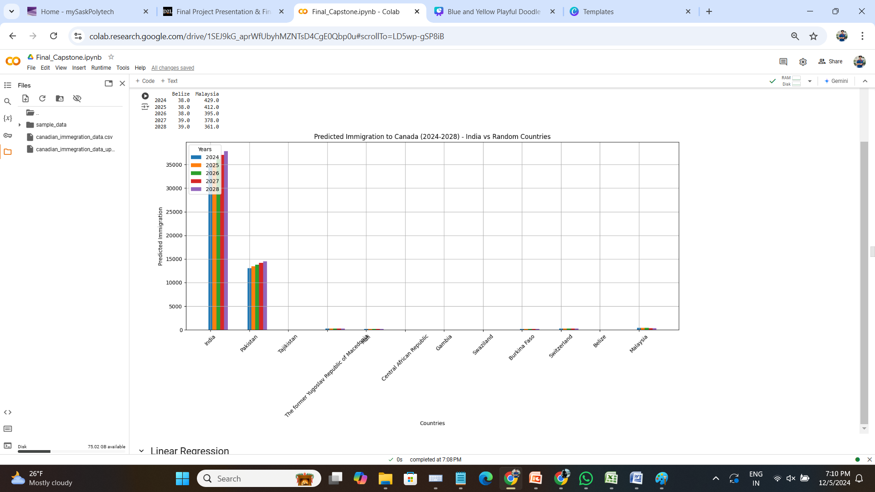
Predicted Immigration to Canada for year 2024-2028 (India vs Random Countries)

Slide 12

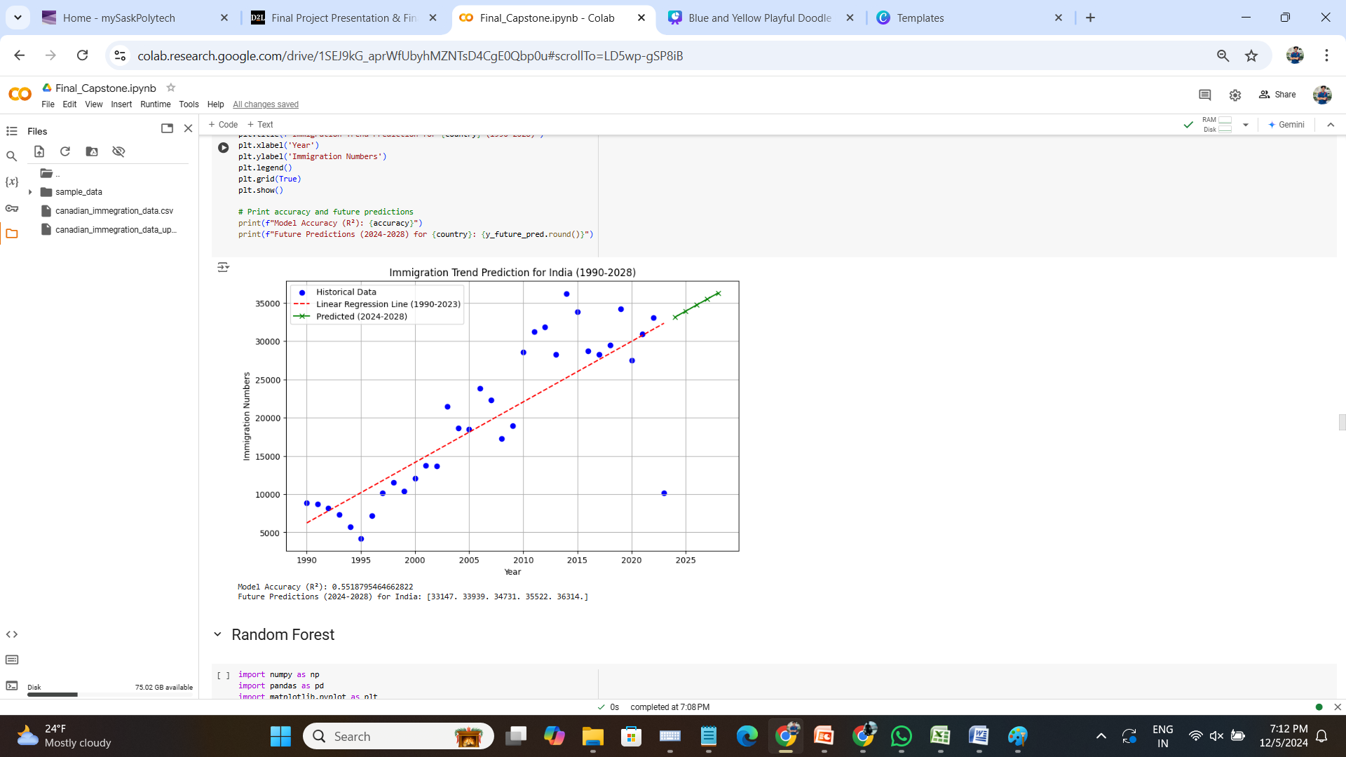
Immigration Trend Prediction for India (Linear regression Model)

Slide 13
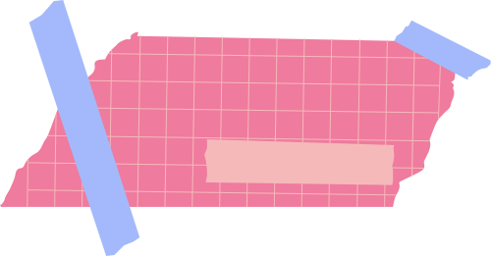
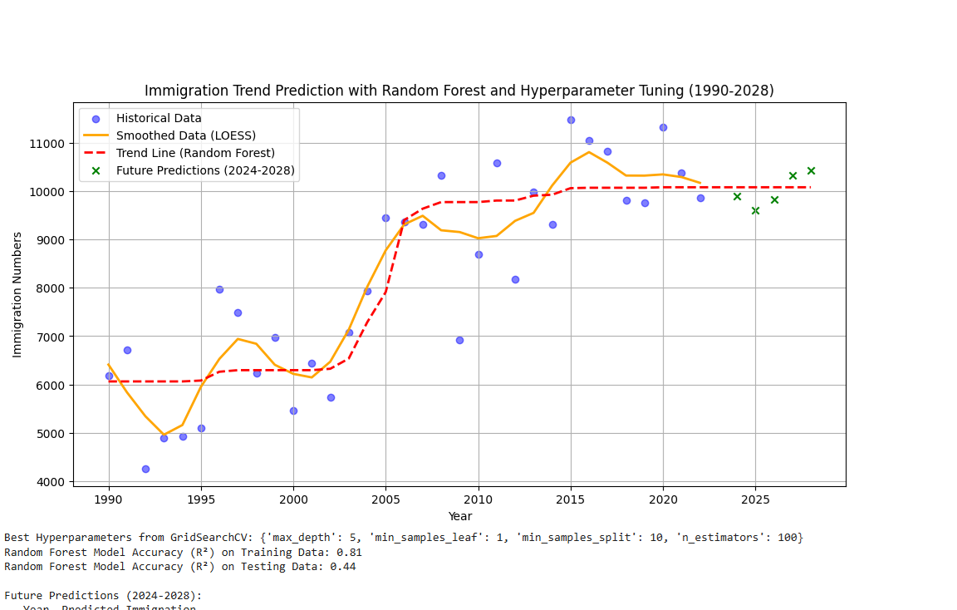
Immigration Trend By random forest and Time series with smoothed data

Slide 14


"CONCLUSION AND FUTURE SCOPE"
SUMMARY OF FINDINGS
IMPACT
FUTURE ENHANCEMENTS
The project demonstrated the effectiveness of models like LDA for dimensionality reduction, Linear Regression for trend prediction, and Random Forest for identifying key features influencing Canadian immigration trends.
The project provides actionable insights into Canadian immigration trends, aiding policymakers and stakeholders in planning and decision-making for 2024-2028.
Explore advanced models for better accuracy, expand the dataset with additional variables, and apply findings to real-world policy-making and immigration planning scenarios.

Slide 15

THANK
YOU!

